Slide 1
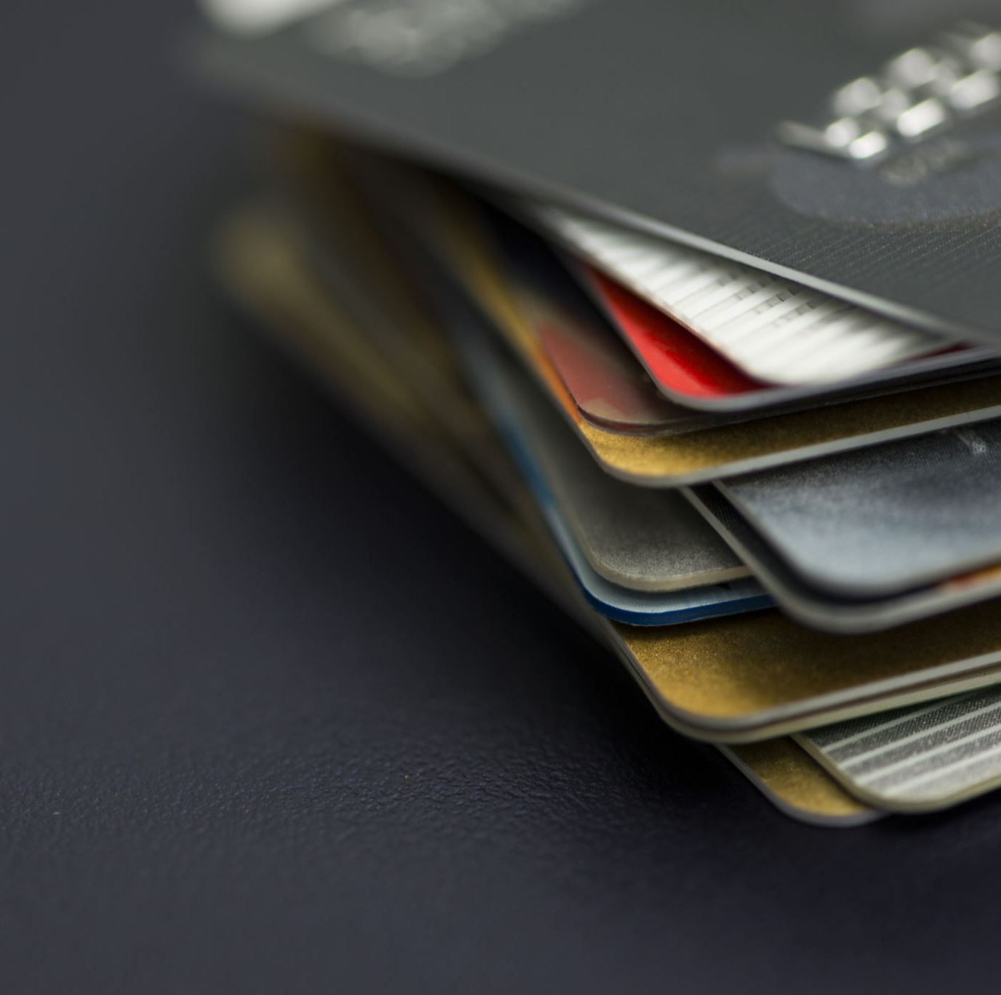
Tailoring Credit Cards for Tomorrow: Customer Insights & Strategic Directions for Mitron Bank
Live Dashboard: Mitron Bank Customer Insights

Slide 2

AGENDA
Overview
Data Overview
Dashboard
Recommendations
Conclusion
Q&A

Slide 3
01
Introduction
Problem Statement & Summary

Slide 4
1. Introduction – Problem Statement
Mitron Bank's Goal is to introduce a new line of credit cards to expand market reach.

Slide 5
1. Introduction – Summary
Project Overview
AtliQ's Proposal
Offered to implement the project using data-driven insights.
Mr. Bashnir Rover's Condition
Sample dataset: 4000 customers across five cities.
Pilot success critical for full project approval and strategy development.
Approval is contingent on a successful pilot project.
Pilot Project Data
Focus
Analyze online spending patterns to inform credit card features.
Outcome

Slide 6
1. Introduction – End Goal
Customer Demographics & Income/Expenditure Insights
Providing data driven decisions to increase credit card usage
End Goal

Slide 7
1. Introduction – Project Initialization
Demographics
Depiction of Diverse Customer Base
Segment-Specific Insights
Income & Expense Analytics
Illustration of Spending Habits
Mitron Bank Customer Insights Dashboard
Insights on Payment Preference

Slide 8
02
Data Info
All About Data

Slide 9
2. Data Description
dim_customers
gender
fact_spends
customer_id
Data Tables
spends
age_group
marital_status
City
month
category
payment_type
Occupation
average_income
customer_id

Slide 10
03
Dashboard

Slide 11
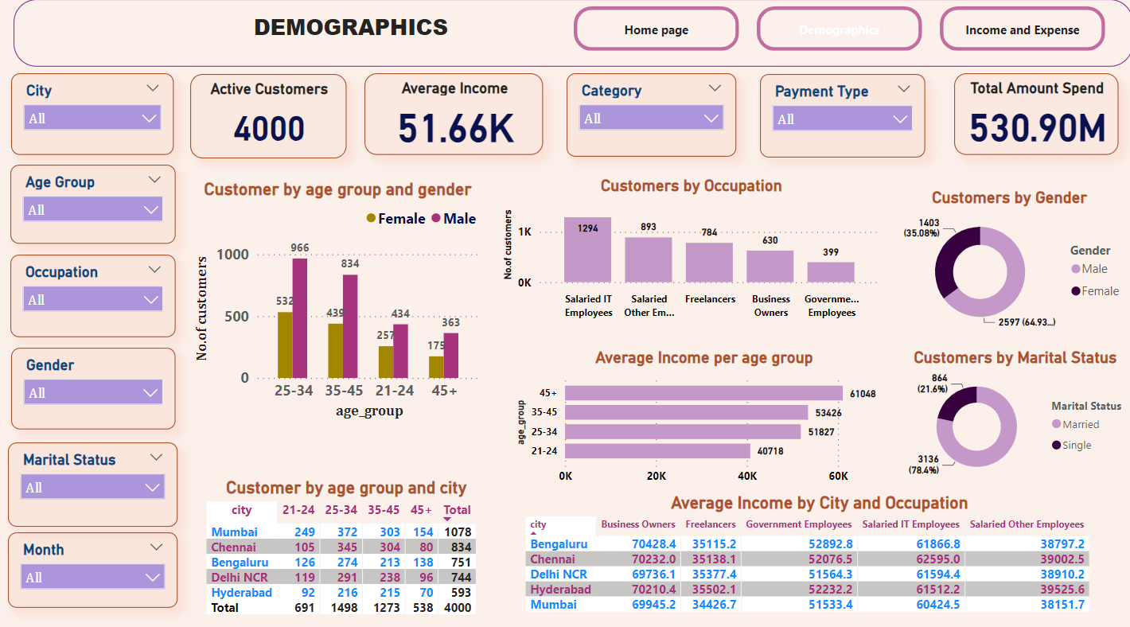
4. Dashboard– Customer Demographics

Slide 12
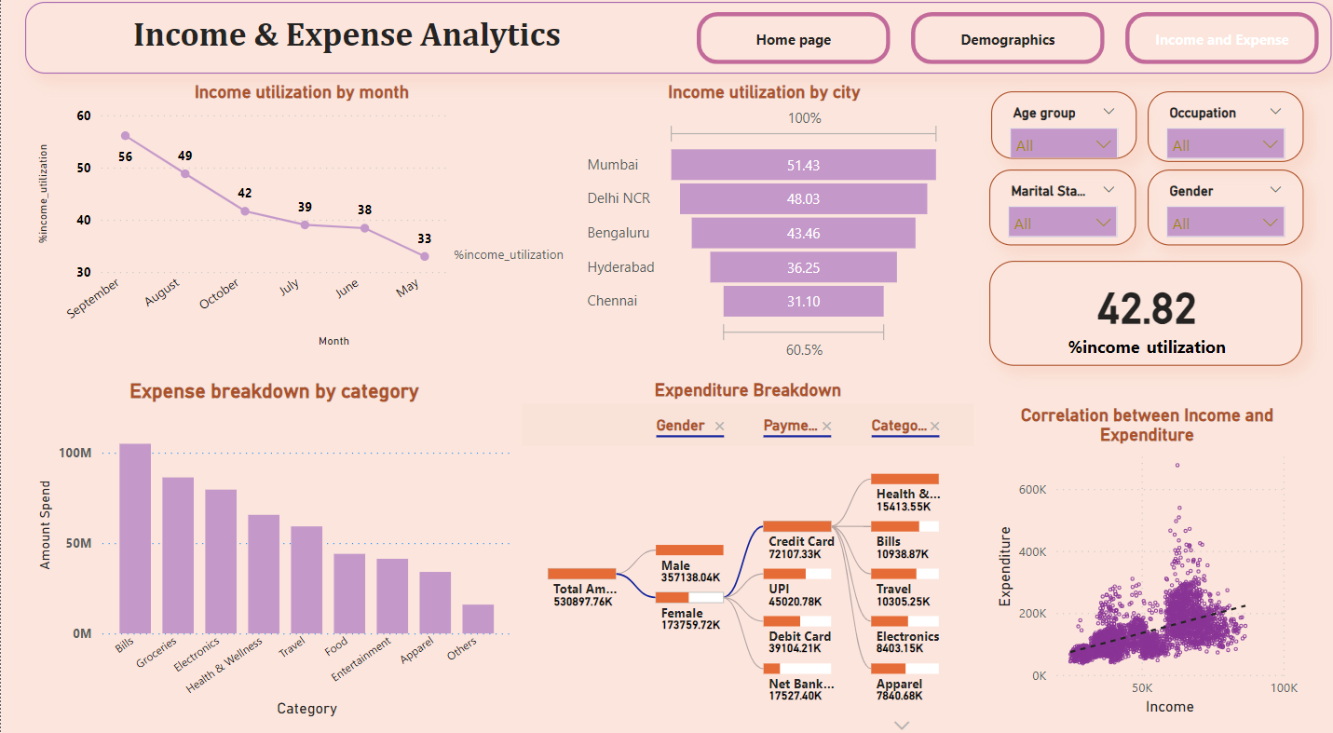
4. Dashboard – Income & Expense Analytics

Slide 13
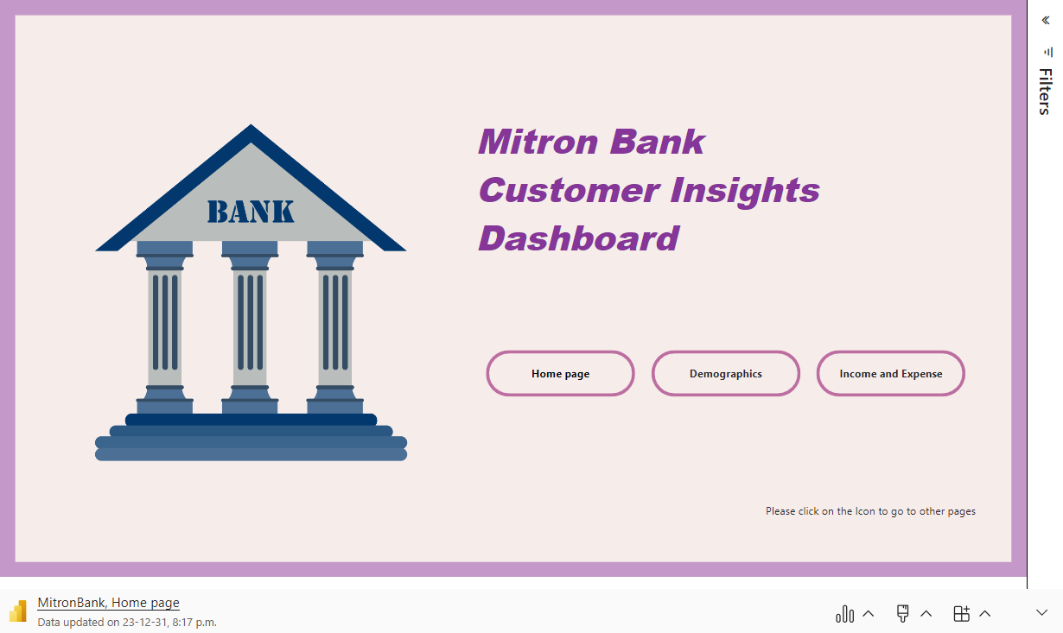

Slide 14
4. Key Segment Analysis
1. Age Group Segment: 25-34 to 35-45 Age Group
Customer Base: ~70%
Income Utilization: Higher at 1.25%
Spending Contribution: ~75% of total spending.
Top 5 Spending Categories: Bills, Groceries, Health and Wellness,Electronics, Travel
2. Gender Segment: Male
Customer Base: 64.9%
Income Utilization: Higher at 1.24%
Spending Contribution: 64.9% of total spending.
Top 5 Spending Categories: Bills, Groceries, Electronics, Travel, Entertainment
3. Occupation Segment: Salaried IT Employees
Customer Base: 32.35%
Income Utilization: Highest at 1.41%
Spending Contribution: 46% of total spending.
Top 5 Spending Categories: Bills, Groceries, Electronics, Health and Wellness, Travel
4. City Segment: Mumbai and Delhi NCR
Customer Base: ~48%
Income Utilization: Higher in Mumbai (1.43%) and Delhi NCR (1.34%)
Spending Contribution: ~53% of total spending.
Top 5 Spending Categories: Bills, Groceries, Electronics, Health and Wellness, Travel

Slide 15
Potential Recommendations
1. Personalized Rewards Program
Tailor rewards to align with the top spending categories for the 25-34 to 35-45 Age Group, including bills, groceries, health and wellness, electronics, and travel.
2. Enhanced Cashback Offers
Introduce cashback offers specifically targeted at the top spending categories for the Male segment: bills, groceries, electronics, travel, and entertainment.
3. Health and Wellness Benefits
Offer exclusive health and wellness benefits, considering the significant spending in this category by the Salaried IT Employees segment.
4. Exclusive Electronic Discounts
Provide special discounts and offers on electronics purchases, catering to the preferences of the 25-34 to 35-45 Age Group, Male segment, and Salaried IT Employees.
5. Travel Rewards and Perks
Introduce travel-related rewards and perks for the Age Group, Male, and City Segment (Mumbai and Delhi NCR) customers who show a high inclination towards travel-related spending.

Slide 16
Potential Recommendations
6. Launch Targeted Credit Card Promotions
Launch targeted credit card promotions during months with the highest income utilization to drive sign-ups and spending.
7. Smart Bill Management
Implement features that assist in managing and tracking monthly bills, a consistent top spending category across all segments.
8. Priority Customer Service for Salaried IT Employees
Offer priority customer service to Salaried IT Employees who contribute significantly to the total spending.
9. Exclusive Entertainment Offers
Provide special offers and benefits for entertainment-related spending, recognizing its significance in the Male segment's spending patterns.
10. Grocery Shopping Benefits
Offer incentives, discounts, or cashback for grocery shopping, as it consistently ranks among the top spending categories for all segments.

Slide 17

THANK YOU

